Slide 1
JSP Database Example

Slide 2
We will create a Login page to enter user name and password and one link for Registration page for new user registration.
On submit, validate the user name/password against MySQL database.
If the authentication is successful, forward to home page showing welcome message along with the user name.
If the authentication fails, return back to the login page with appropriate error message.
If there is exception/errors during authentication process return back to login page with appropriate error message.

Slide 3
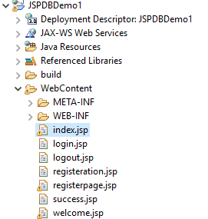
Directory Structure

Slide 4
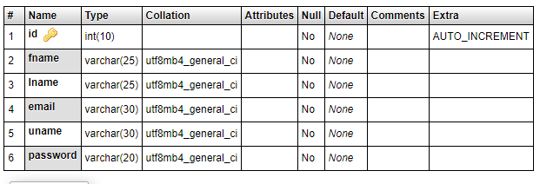
Employee Table

Slide 5
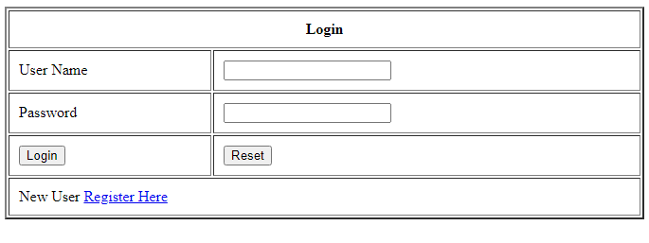

Slide 6
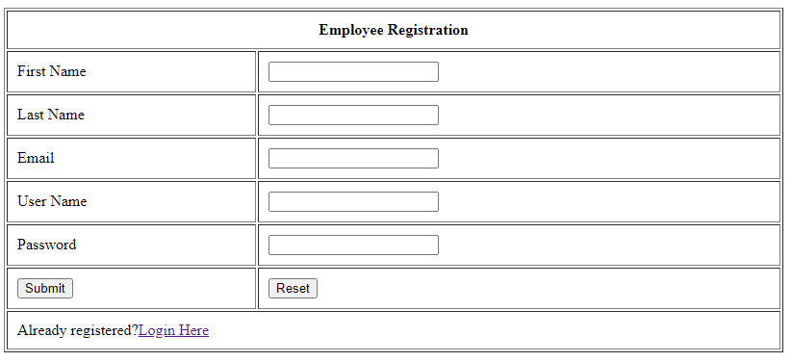

Slide 7
<form method="post" action="login.jsp">
<table border="2" width="50%" cellpadding="10">
<tr>
<th colspan="2">Login </th>
</tr>
<tr><td>User Name</td>
<td>
<input type="text" name="username" value="" />
</td>
</tr>
<tr>
<td>Password</td>
<td><input type="password" name="password" value="" /></td>
</tr>
<tr>
<td><input type="submit" value="Login" /></td>
<td><input type="reset" value="Reset" /></td>
</tr>
<tr>
<td colspan="2" >New User <a href="registerpage.jsp">Register Here</a></td>
</tr>
</table>
</form>
index.jsp

Slide 8
<body>
<%@page import="java.sql.ResultSet"%>
<%@page import="java.sql.Statement"%>
<%@page import="java.sql.Connection"%>
<%@page import="java.sql.DriverManager"%>
<%
String userName = request.getParameter("username");
String password = request.getParameter("password");
Class.forName("com.mysql.jdbc.Driver");
Connection con = DriverManager.getConnection("jdbc:mysql://localhost:3306/EmpDB","root","");
Statement st= con.createStatement();
ResultSet rs;
rs = st.executeQuery("select * from employee where uname='"+ userName + "' and password='" + password + "'");
if (rs.next()) {
session.setAttribute("username", userName);
response.sendRedirect("success.jsp");
}
else
{
out.println("Invalid password <a href='index.jsp'>try again</a>");
}
%>
</body>
login.jsp

Slide 9
registerpage.jsp
<form method="post" action="registeration.jsp">
<table border="1" width="60%" cellpadding="10" >
<tr>
<th colspan="2">Employee Registration </th>
</tr>
<tr>
<td>First Name</td>
<td><input type="text" name="firstname" value="" /></td>
</tr>
<tr>
<td>Last Name</td>
<td><input type="text" name="lastname" value="" /></td>
</tr>
<tr>
<td>Email</td>
<td><input type="text" name="email" value="" /></td>
</tr>
<tr>
<td>User Name</td>
<td><input type="text" name="username" value="" /></td>
</tr>
<tr>
<td>Password</td>
<td><input type="password" name="password" value="" /></td>
</tr>
<tr>
<td><input type="submit" value="Submit" /></td>
<td><input type="reset" value="Reset" /></td>
</tr>
<tr>
<td colspan="2">Already registered?<a href="index.jsp">Login Here</a></td>
</tr>
</table>
</form>

Slide 10
<body>
<%@page import="java.sql.Statement"%>
<%@page import="java.sql.Connection"%>
<%@page import="java.sql.DriverManager"%>
<%
String userName = request.getParameter("username");
String password = request.getParameter("password");
String firstName = request.getParameter("firstname");
String lastName = request.getParameter("lastname");
String email = request.getParameter("email");
Class.forName("com.mysql.jdbc.Driver");
Connection con = DriverManager.getConnection("jdbc:mysql://localhost:3306/EmpDB","root","");
Statement st= con.createStatement();
int i = st.executeUpdate("insert into employee(fname, lname, email, uname, password) values ('"
+ firstName + "','" + lastName + "','" + email + "','" + userName + "','"
+ password
+ "')");
if (i > 0) {
response.sendRedirect("welcome.jsp");
} else {
response.sendRedirect("index.jsp");
}
%>
</body>
registeration.jsp

Slide 11
success.jsp
<body>
<%
if ((session.getAttribute("username") == null) || (session.getAttribute("username") == ""))
{ %>
You are not logged in<br/>
<a href="index.jsp">Please Login</a>
<%}
else {
%>
Welcome <br>
<h1> <%=session.getAttribute("username")%> </h1> <br>
<h1> <a href='logout.jsp'>Log out</a> </h1>
<%
}
%>
</body>

Slide 12
welcome.jsp
<body>
Registration is Successful.
Please Login Here <a href='index.jsp'>Go to Login
</body>
logout.jsp
<body>
<%
session.setAttribute("username", null);
session.invalidate();
response.sendRedirect("index.jsp");
%>

